Slide 1
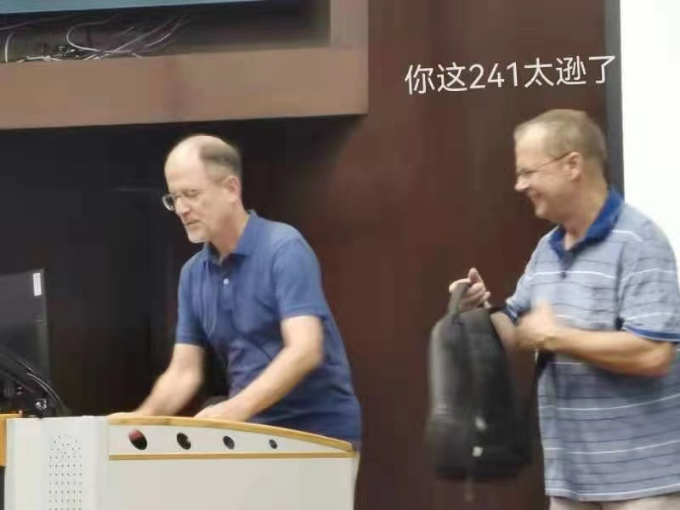
MATH 285 Week 5,6 DI 2

Slide 2
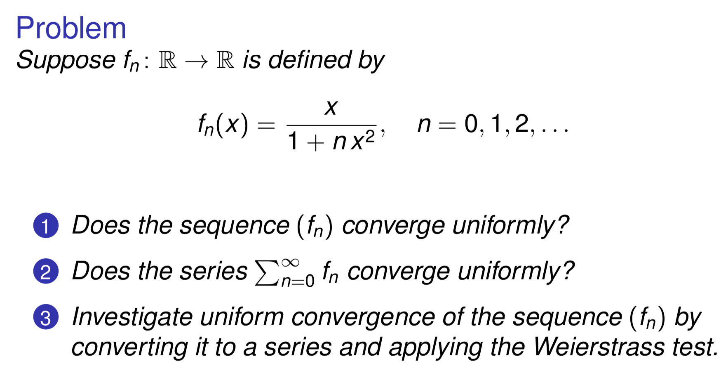
Some former stuff....

Slide 3

Picard-Lindelöf iteration (The method of successive approximations)

Slide 4
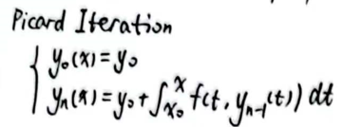


Slide 5
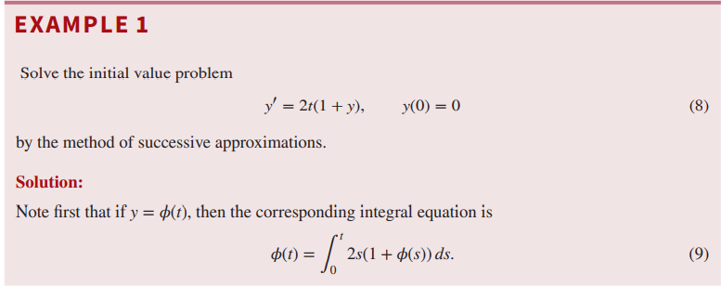

Slide 6
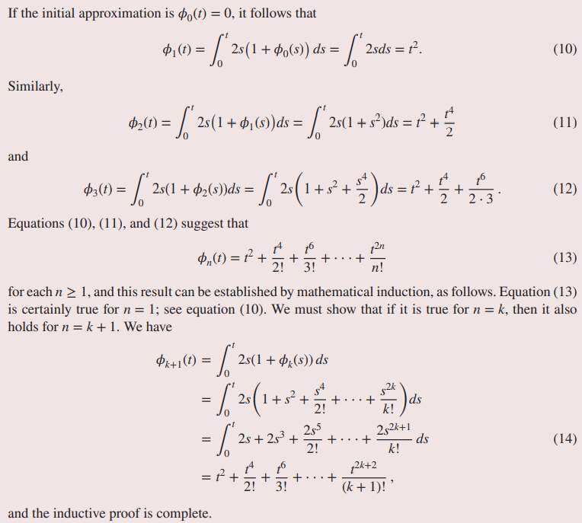

Slide 7


Slide 8
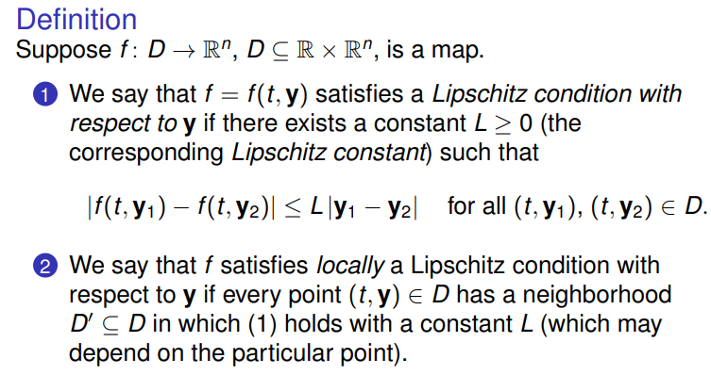
Lipschitz Condition

Slide 9


Slide 10
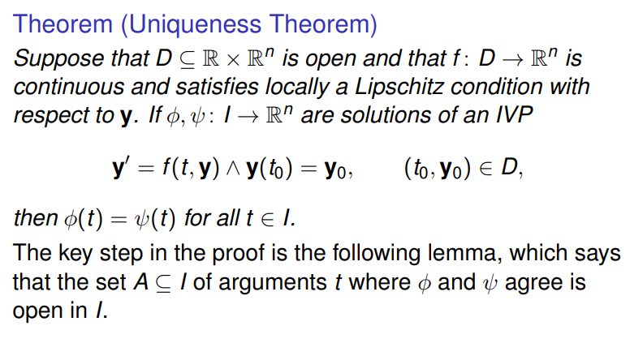
The Uniqueness and Existence Theorem

Slide 11


Slide 12



Slide 13



Matrix Norms and Frobenius norms
For a matrice A, the norm of A is
Let
is more simple. (Root of the sum of the squares)

Slide 14


Slide 15


Slide 16


Slide 17
Next Week Stuff....

Slide 18
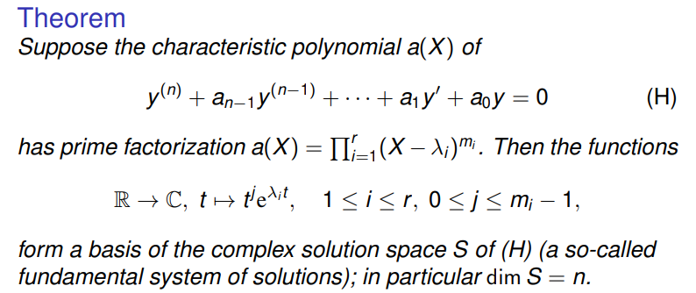
Second-order (or Higher) Ordinary Differential Equation

Slide 19



Slide 20
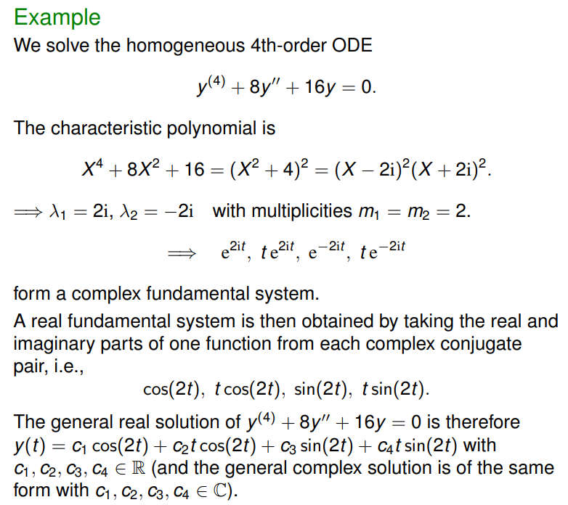

Slide 21

Inhomogeneous Case

Slide 22


Slide 23

Determine C ? Two ways

Slide 24


Slide 25
